Slide 1


Data Science Practicum (Lecture 7, 30.10.)
Denisa Šrámková

Slide 2
eXplainable Artificial Intelligence (XAI)
Terminology
Global explainability
Feature importance
Local explainability
SHAP
Heavily inspired by: https://github.com/BioGeMT/MALTAomics-Summer-School/tree/main/Day3_WorkshopIV_ExplainableAI

Slide 3

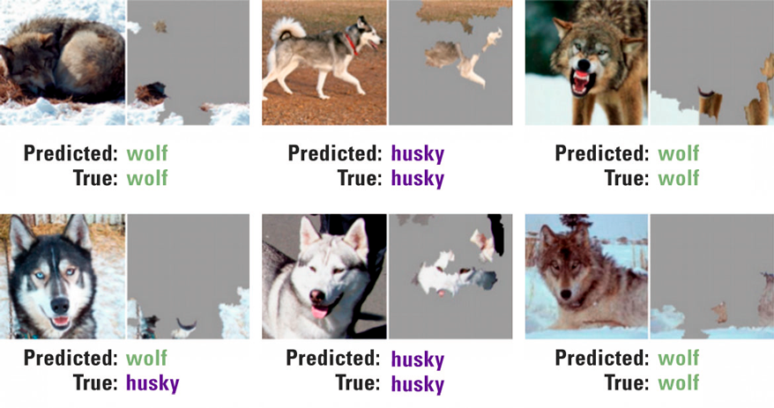
Motivation
https://www.compact.nl/en/articles/deep-learning-finding-that-perfect-fit/

Slide 4







Terminology
Interpretability
The model is transparent in its operation and provides information about relationships between inputs and outputs.
Explainability
The model provides clear and intuitive explanation of the decisions made, enabling us to understand why the model produced a particular result.
Black box
Notes:
Interpretability focuses on understanding the inner workings of the models, while explainability focuses on explaining the decisions made. Consequently, interpretability requires a greater level of detail than explainability.
“Glass box”

Slide 5


Example
Input data Model Output
71.51% “American stafford terrier” 9.01% “Border collie” 1.54% “Wiener dog” …

Slide 6
Example
Input data Model Output
71.51% “American stafford terrier” 9.01% “Border collie” 1.54% “Wiener dog” …
Current explanation: This is an American stafford terrier.

Slide 7
Example
Input data Model Output
71.51% “American stafford terrier” 9.01% “Border collie” 1.54% “Wiener dog” …
Current explanation: This is an American stafford terrier.
XAI methods + domain knowledge

Slide 8
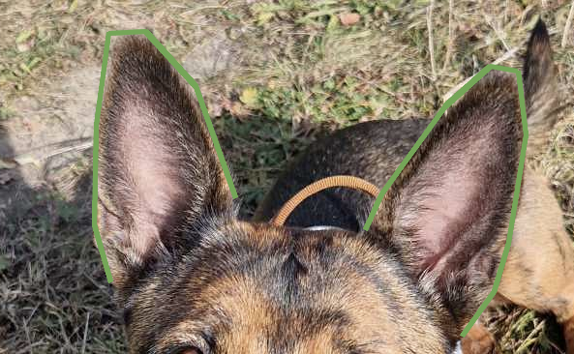
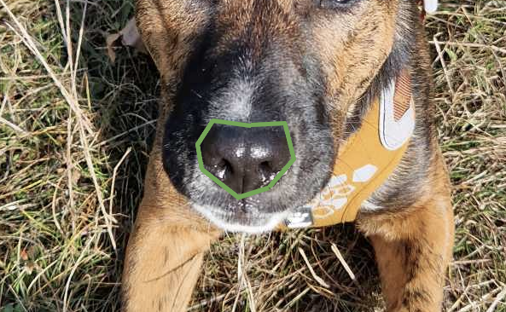
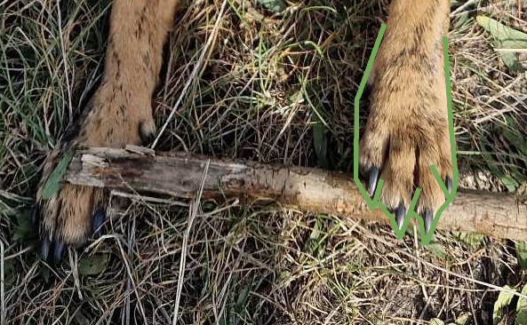
Example
Input data Model Output
71.51% “American stafford terrier” 9.01% “Border collie” 1.54% “Wiener dog” …
Current explanation: This is an American stafford terrier.
XAI explanations: - it has pointy ears, round black nose, tiny paws
- it has this feature
XAI methods + domain knowledge

Slide 9
Types of explainability methods
1. Is my model directly interpretable?
ML model

Slide 10
Types of explainability methods
1. Is my model directly interpretable?
yes
ML model
Interpretability
Notes:
glass-box model

Slide 11
Types of explainability methods
1. Is my model directly interpretable?
yes
ML model
Interpretability
no
Explainability
Notes:
Black-box
Now we can divide explainability methods either as

Slide 12
Types of explainability methods
1. Is my model directly interpretable?
yes
ML model
Interpretability
A) Is the XAI method specific for the model type?
no
Explainability

Slide 13
Types of explainability methods
1. Is my model directly interpretable?
yes
ML model
Interpretability
A) Is the XAI method specific for the model type?
no
Explainability
Model-specific
yes

Slide 14
Types of explainability methods
1. Is my model directly interpretable?
yes
ML model
Interpretability
A) Is the XAI method specific for the model type?
no
Explainability
Model-specific
yes
no
Model-agnostic

Slide 15
Types of explainability methods
1. Is my model directly interpretable?
yes
ML model
Interpretability
B) Does the method describe the average behaviour of the model?
no
Explainability

Slide 16
Types of explainability methods
1. Is my model directly interpretable?
yes
ML model
Interpretability
B) Does the method describe the average behaviour of the model?
no
Explainability
yes
Global

Slide 17
Types of explainability methods
1. Is my model directly interpretable?
yes
ML model
Interpretability
B) Does the method describe the average behaviour of the model?
no
Explainability
yes
Global
no
Local

Slide 18
Concrete methods
Model-agnostic
Global
Local
Model-specific
Notes:
model-agnostic = it is not restricted to a certain model type
global = it only provides explanations for a full dataset, but not for individual samples
local= it only provides explanations for individual samples (however, in some cases, the individual explanations can be used to also get global interpretations)

Slide 19
Concrete methods
Model-agnostic
x Partial Dependence Plots
x Local Interpretable Model-Agnostic Explanations (LIME)
x Global Surrogate
x Permutation Feature Importance
x SHAP
Global
Local
x Integrated Gradients (IG)
x Global Attribution Mapping
x Grad-CAM
x Forest-Guided Clustering (FGC)
x SmoothGrad
Model-specific

Slide 20
Concrete methods
Model-agnostic
x Partial Dependence Plots
x Local Interpretable Model-Agnostic Explanations (LIME)
x Global Surrogate
x Permutation Feature Importance
x SHAP
Global
Local
x Integrated Gradients (IG)
x Global Attribution Mapping
x Grad-CAM
x Forest-Guided Clustering (FGC)
x SmoothGrad
Model-specific

Slide 21
Permutation Feature Importance
We measure the importance of a feature as an increase in loss when the feature is permuted.
Notes:
model-agnostic = it is not restricted to a certain model type
global = it only provides explanations for a full dataset, but not for individual samples
We have a trained model and measure its performance on our dataset == baseline
For each feature
Permute the feature values across dataset (messing up connection between label and this feature)
Get predictions for this dataset with permuted feature values.
Compare permuted results to baseline.
- we use the difference as importance of the feature
(performances:
Similar – removing feature did not result in performance decrease, model does not rely on it,
Permuted performance lower than baseline: model highly depends on the feature to produce good scores)

Slide 22
Permutation Feature Importance
We measure the importance of a feature as an increase in loss when the feature is permuted.
feature A feature B feature C feature D label sample 1 sample 2 sample 3 sample 4 sample 5 sample 6
Notes:
We have a black box model for binary classification and image we use it on this dataset, that consists of 6 samples and has 4 features.

Slide 23
Permutation Feature Importance
We measure the importance of a feature as an increase in loss when the feature is permuted.
feature A feature B feature C feature D label sample 1 sample 2 sample 3 sample 4 sample 5 sample 6
Notes:
We have a black box model for binary classification and image we use it on this dataset, that consists of 6 samples and has 4 features.

Slide 24
Permutation Feature Importance
We measure the importance of a feature as an increase in loss when the feature is permuted.
feature A feature B feature C feature D label sample 1 sample 2 sample 3 sample 4 sample 5 sample 6
Notes:
If we want to e.g. understand the importance of feature D we need to:
create a second dataset and remove feature D from it.

Slide 25
Permutation Feature Importance
We measure the importance of a feature as an increase in loss when the feature is permuted.
feature A feature B feature C feature D label A B C D label sample 1 1 sample 2 2 sample 3 3 sample 4 4 sample 5 5 sample 6 6
Notes:
We can’t actually remove feature D, so we have to do a little trick here: permutation.
We take the feature values of feature D, we randomly shuffle them and put them back into the dataset.
Permutation break relationship between the feature and the true outcome (basically like artificially removing D from our dataset).

Slide 26
Permutation Feature Importance
We measure the importance of a feature as an increase in loss when the feature is permuted.
A B C D label A B C D label sample 1 1 sample 2 2 sample 3 3 sample 4 4 sample 5 5 sample 6 6
Notes:
Now we can compare how our black box model performs on each of those two data sets.
So we use our model on the original dataset and the second, permuted one, and then we can calculate the error that the model is doing based on the predictions.

Slide 27
Permutation Feature Importance
We measure the importance of a feature as an increase in loss when the feature is permuted.
A B C D label predictions A B C D label preds sample 1 1 sample 2 2 sample 3 3 sample 4 4 sample 5 5 sample 6 6
Notes:
Now we can compare how our black box model performs on each of those two data sets.
So we use our model on the original dataset and the second, permuted one, and then we can calculate the error that the model is doing based on the predictions.
To compute the feature importance we simply subtract the original error from the permuted error.

Slide 28
Permutation Feature Importance
We measure the importance of a feature as an increase in loss when the feature is permuted.
A B C D label predictions A B C D label preds sample 1 1 sample 2 2 sample 3 3 sample 4 4 sample 5 5 sample 6 6
error
error
Notes:
To compute the feature importance we simply subtract the original error from the permuted error.
How to interpret:
E.g. you get low feature importance score close to 0 (the difference between errors is low) => the error the model is doing when we remove the feature D is not very high => feature D does not have high impact on the prediction accuracy of our model
If error high => feature D is important

Slide 29
Permutation Feature Importance
We measure the importance of a feature as an increase in loss when the feature is permuted.
Note: Feature independence is assumed (features are not correlated). We might observe that the importance of highly correlated features will be lower (because the importance gets split between correlated features).
Notes:
model-agnostic = it is not restricted to a certain model type
global = it only provides explanations for a full dataset, but not for individual samples
We have a trained model and measure its performance on our dataset == baseline
For each feature
Permute the feature values across dataset (messing up connection between label and this feature)
Get predictions for this dataset with permuted feature values.
Compare permuted results to baseline.
- we use the difference as importance of the feature
(performances:
Similar – removing feature did not result in performance decrease, model does not rely on it,
Permuted performance lower than baseline: model highly depends on the feature to produce good scores)

Slide 30
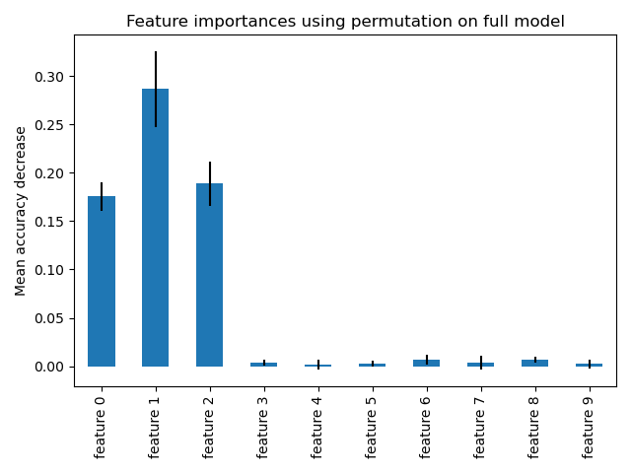
Interpreting Feature Importance results

Slide 31
Exercise 1
Tabular data: https://github.com/simecek/dspracticum2023/blob/main/lesson07/ds_practicum_ex1_feature_importance.ipynb

Slide 32
SHapley Additive exPlanations (SHAP)
We compute the contribution of each feature to the model prediction for some specific input.
Notes:
model-agnostic = it is not restricted to a certain model type
local= it only provides explanations for individual samples (however, in some cases, the individual explanations can be used to also get global interpretations)
Based on estimating Shapley Values (they actually measure the contribution of each feature to the prediction) in an effective way
=> enables us to compute more of them and aggregate them to global interpretation measures

Slide 33
SHapley Additive exPlanations (SHAP)
We compute the contribution of each feature to the model prediction for some specific input.
feature A feature B feature C feature D label sample 1 sample 2 sample 3 sample 4 sample 5 sample 6
Notes:
We have the same dataset and model as before.

Slide 34
SHapley Additive exPlanations (SHAP)
We compute the contribution of each feature to the model prediction for some specific input.
feature A feature B feature C feature D label sample 1 sample 2 sample 3 sample 4 sample 5 sample 6
Notes:
For example we want to understand the contribution of each of those 4 features of sample 2 to the prediction.

Slide 35
SHapley Additive exPlanations (SHAP)
We compute the contribution of each feature to the model prediction for some specific input.
feature A feature B feature C feature D label A B C D sample 1 2 sample 2 sample 3 marginal contribution Φ(A) sample 4 for different feature sets s sample 5 sample 6
Notes:
To do that, we have to calculate the Shapley values for each of those features separately.
Let’s assume we want to calculate the Shapley value for feature A. Therefore, we have to calculate the marginal contribution for different sets of features. Afterwards we sum this marginal contribution in a weighted fashion to get the Shapley values.

Slide 36
SHapley Additive exPlanations (SHAP)
We compute the contribution of each feature to the model prediction for some specific input.
feature A feature B feature C feature D label A B C D sample 1 2 sample 2 sample 3 marginal contribution Φ(A) sample 4 for different feature sets s sample 5 sample 6 Φ(A) = f(s+A) - f(s-A)
Notes:
What is this marginal distribution:
It is the prediction of our black box model f model a feature set where A is present minus the prediction of a black box model on a feature set where A is absent.
Bud how do we remove A from the data set? We can artificially remove it by randomly permuting its values. This random permutation breaks the relationship between feature A and all the other features in the dataset as well as the target (label).

Slide 37
SHapley Additive exPlanations (SHAP)
We compute the contribution of each feature to the model prediction for some specific input.
feature A feature B feature C feature D label A B C D sample 1 2 sample 2 sample 3 marginal contribution Φ(A) sample 4 for different feature sets s sample 5 sample 6 Φ(A) = f(s+A) - f(s-A) A B C D B C D
Notes:
So now we are considering these feature sets.
The full feature set - enables us to measure the total effect that feature A has on prediction of the black box model f. The total effect includes the main effect of feature A as well as the interaction effect of feature A with all other features.
In next step we want to consider the interaction between feature A and subset of other features.

Slide 38
SHapley Additive exPlanations (SHAP)
We compute the contribution of each feature to the model prediction for some specific input.
feature A feature B feature C feature D label A B C D sample 1 2 sample 2 sample 3 marginal contribution Φ(A) sample 4 for different feature sets s sample 5 sample 6 Φ(A) = f(s+A) - f(s-A) A _ C D _ C D
Notes:
Therefore we subsequently remove one of the features and also combinations of the features.

Slide 39
SHapley Additive exPlanations (SHAP)
We compute the contribution of each feature to the model prediction for some specific input.
feature A feature B feature C feature D label A B C D sample 1 2 sample 2 sample 3 marginal contribution Φ(A) sample 4 for different feature sets s sample 5 sample 6 Φ(A) = f(s+A) - f(s-A) A B _ D B _ D
Notes:
Therefore we subsequently remove one of the features and also combinations of the features.

Slide 40
SHapley Additive exPlanations (SHAP)
We compute the contribution of each feature to the model prediction for some specific input.
feature A feature B feature C feature D label A B C D sample 1 2 sample 2 sample 3 marginal contribution Φ(A) sample 4 for different feature sets s sample 5 sample 6 Φ(A) = f(s+A) - f(s-A) A B C _ B C _
Notes:
Therefore we subsequently remove one of the features and also combinations of the features.

Slide 41
SHapley Additive exPlanations (SHAP)
We compute the contribution of each feature to the model prediction for some specific input.
feature A feature B feature C feature D label A B C D sample 1 2 sample 2 sample 3 marginal contribution Φ(A) sample 4 for different feature sets s sample 5 sample 6 Φ(A) = f(s+A) - f(s-A) A _ _ D _ _ D
Notes:
Therefore we subsequently remove one of the features and also combinations of the features.

Slide 42
SHapley Additive exPlanations (SHAP)
We compute the contribution of each feature to the model prediction for some specific input.
feature A feature B feature C feature D label A B C D sample 1 2 sample 2 sample 3 marginal contribution Φ(A) sample 4 for different feature sets s sample 5 sample 6 Φ(A) = f(s+A) - f(s-A) A _ C _ _ C _
Notes:
Therefore we subsequently remove one of the features and also combinations of the features.

Slide 43
SHapley Additive exPlanations (SHAP)
We compute the contribution of each feature to the model prediction for some specific input.
feature A feature B feature C feature D label A B C D sample 1 2 sample 2 sample 3 marginal contribution Φ(A) sample 4 for different feature sets s sample 5 sample 6 Φ(A) = f(s+A) - f(s-A) A B _ _ B _ _
Notes:
Therefore we subsequently remove one of the features and also combinations of the features.

Slide 44
SHapley Additive exPlanations (SHAP)
We compute the contribution of each feature to the model prediction for some specific input.
feature A feature B feature C feature D label A B C D sample 1 2 sample 2 sample 3 marginal contribution Φ(A) sample 4 for different feature sets s sample 5 sample 6 Φ(A) = f(s+A) - f(s-A) A _ _ _ _ _ _
Notes:
Therefore we subsequently remove one of the features and also combinations of the features.
We also want to consider the feature set when none of the other features are present. This helps us to measure the main effect of feature A on the prediction of the black box model f.
After we have measured the marginal contribution of all those different feature sets we get the Shapley value by summing up those marginal contribution and weighting hem accordingly to the feature set.

Slide 45
SHapley Additive exPlanations (SHAP)
We compute the contribution of each feature to the model prediction for some specific input.
feature A feature B feature C feature D label A B C D sample 1 2 sample 2 sample 3 marginal contribution Φ(A) sample 4 for different feature sets s sample 5 sample 6 Φ(A) = f(s+A) - f(s-A)
Shapley value (contribution): Φ(A) = ∑ wsΦs(A)
s ∈ S
Notes:
After we have measured the marginal contribution of all those different feature sets we get the Shapley value by summing up those marginal contribution and weighting them accordingly to the feature set. Where the largest and smallest sets have the highest weight.

Slide 46
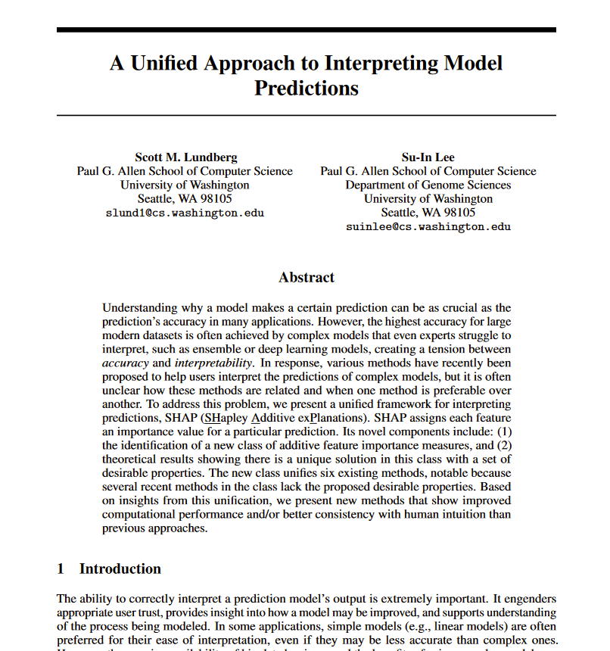
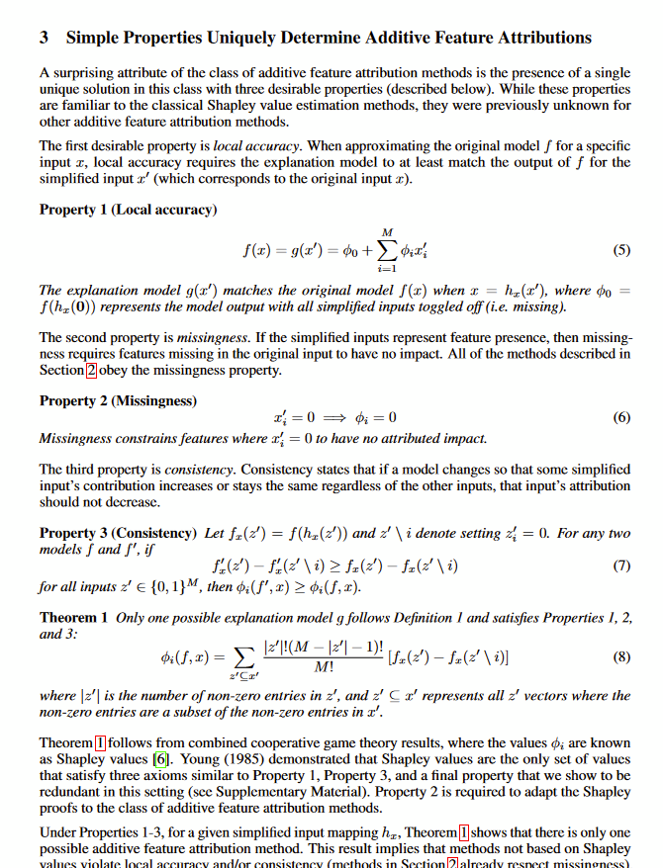
SHAP paper
https://arxiv.org/abs/1705.07874

Slide 47
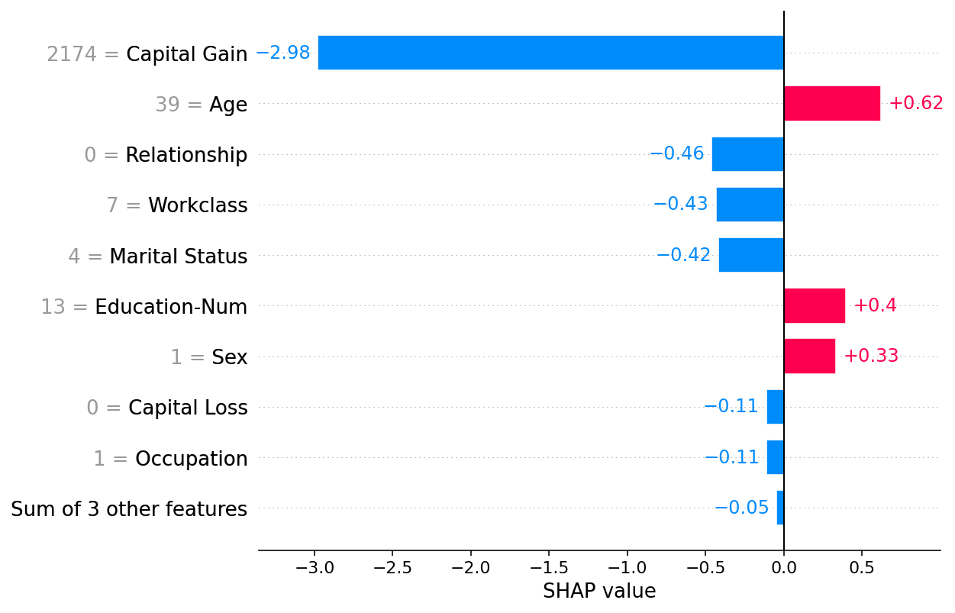
Interpreting SHAP results
Notes:
Explanations are done per instance, here we have the SHAP results for one concrete sample.
One major difference between SHAP and other interpretability methods is that explanations are contrastive == why an event occurred in contrast to some baseline.
In this case the baseline is 0.0. We would get the prediction by summing all these numbers (-2.98+0.62+...). The baseline can be e.g average prediction of the model dor the entire dataset. Otherwise the SHAp results heavily rely on our chosen baseline and there are many approaches we can take in choosing the right baseline (or set of multiple baselines).
Here we can see that we have more negative forces as positive => the prediction was 0.
Important note: independance of features is assumed, if they are, in fact, correlated, the actual contribution may be split between them

Slide 48
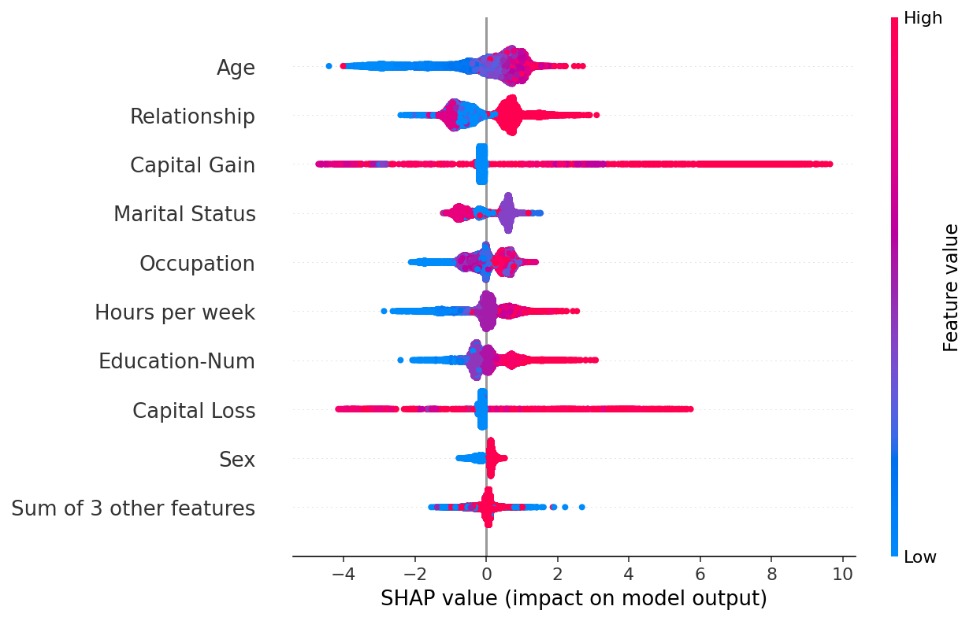
Interpreting SHAP results
Notes:
Each point this plot represents a Shapley value for one feature and one specific instance.
If we e.g. look at second feature from top, we can see that high values lead to high Shapley values. Where for last feature low values lead to high Shapley values.

Slide 49
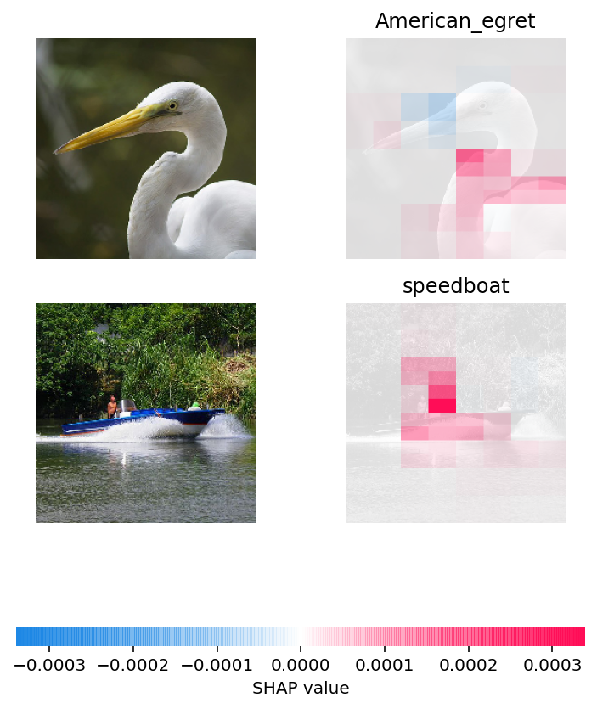
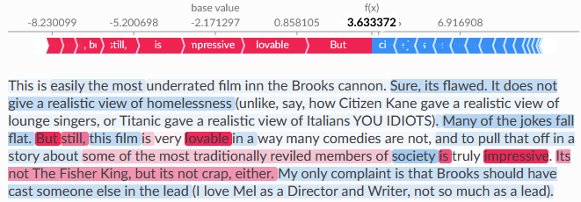
Interpreting SHAP results
Notes:
Each point this plot represents a Shapley value for one feature and one specific instance.
If we e.g. look at second feature from top, we can see that high values lead to high Shapley values. Where for last feature low values lead to high Shapley values.

Slide 50
Exercise 2
Tabular data: https://github.com/simecek/dspracticum2023/blob/main/lesson07/ds_practicum_ex2_shap_tabular.ipynb Text: https://github.com/simecek/dspracticum2023/blob/main/lesson07/ds_practicum_ex2_shap_text.ipynb Images: https://github.com/simecek/dspracticum2023/blob/main/lesson07/ds_practicum_exercise2_shap_images.ipynb

Slide 51
Homework
Choose model and dataset and apply Feature Importance or SHAP on it.
Have a look at few examples and decide whether the model’s decision are correct - it is not making it’s prediction based on some artefact from the data.
Think about how 2) could be done automatically without manually looking at the specific cases (can it be done for your use case?).
Notes:
2) choose representable samples (that are “hard” to classify)

